Slide 1
Overview

Slide 2
Zithini iziphumo zophando lwe-ASPIRE?
Kuqulathwe konke, uphando lwe-ASPIRE (MTN-020) lubonise ukuba i-dapivirine iringi efakwa ekukwini eyi-dapivirine ithintele malunga nesinye kwisithathu sosuleleko lwe-HIV.
Notes:
Phakathi kwabasetyhini abangaphezulu kweminyaka engama-21, abasebenzise iringi rhoqo kunabasetyhini abasebatsha, ngaphezu kwesiqingatha sosuleleko lwe-HIV sathintelwa. Kwi-ASPIRE, nokhuseleko olukhulu ngakumbi luye lwabona ngothotyelo oluphezulwana (ngaphezu kwesibini esithathwini).

Slide 3
Zithini iziphumo zophando lwe-ASPIRE?
Njengezinye iindlela zokuthintela, iringi isebenza kuphela ukuba isetyenziswe ngokuchanekileyo narhoqo. Iringi ibikhuselekile nayo, oku kuthetha ukuba khange ibangele iingxaki zempilo.
Notes:
Olunye uphando oluvavanye iringi efakwa ekukwini eyi-dapivirine, ebizwa i-IPM-027 (UPhando lweRingi), lubonise iziphumo ezifanayo.

Slide 4
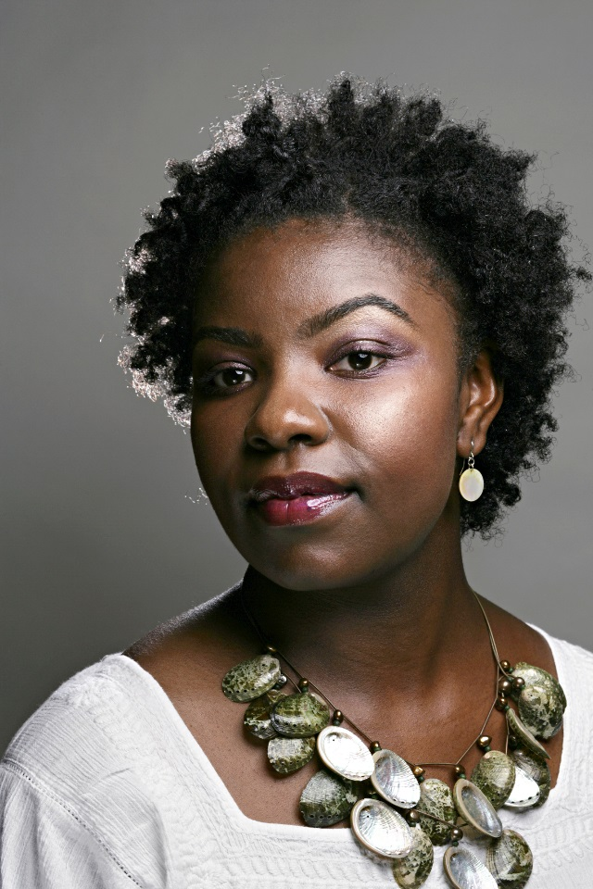
Le yimpumelelo emangalisayo ebengasoze sibenayo ngaphandle kokuzinikela kwabathathi-nxaxheba bethu bophando!
Zithini iziphumo zophando lwe-ASPIRE?

Slide 5
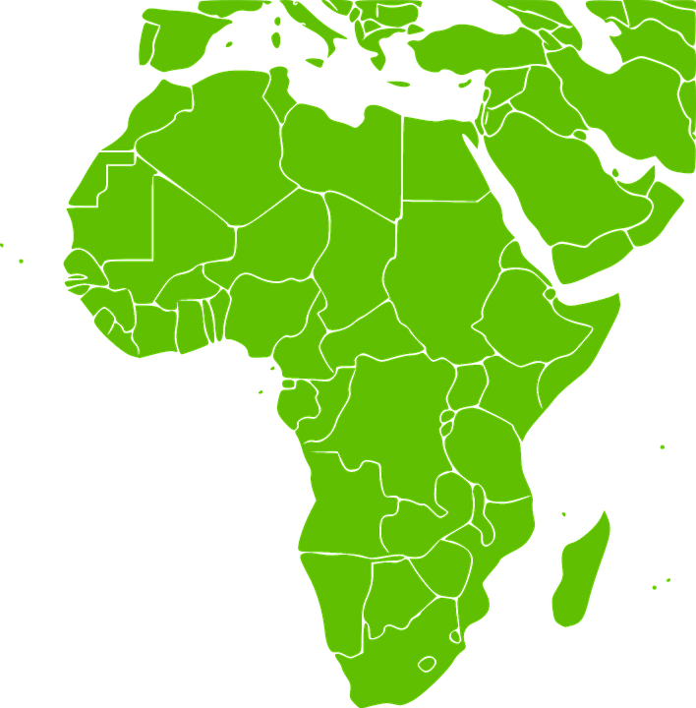
Iza kufumaneka nini iringi efakwa ekukwini eyi-dapivirine kwiindawo esihlala kuzo?
I-IPM, iqela elaphuhlisa iringi, lisebenza noorhulumente namaye amaqela asebenzisana nalo ngenjongo yokwenza iringi ifumaneke kwiindawo esihlala kuzo.
Asiyazi ukuba iringi iza kuvunywa kusini na okanye lingakanani na kanye ixesha elingakanani phambi kokuba iringi ibenokufumaneka, kodwa inkqubo iqhele ukuthatha iminyaka eliqela.
Notes:
Le nkqubo abandakanya imigaqo emininzi nophunyezo lwamazwe olungqalileyo kwaye ngalinye lithatha ixesha.

Slide 6
Kutheni kusenziwa olu phando lwe-HOPE nje?
I-HOPE luphando lwe-Open-Label Extension (OLE), eyilelwe ukubonelela abathathi-nxaxheba ukuba bafikelele kwimveliso yophando esebenzayo phambi kokuba ifumaneke eluntwini.
Notes:
Uphando lwe-Open-Label Extension lukwaqhutyelwa ukuqokelelo ulwazi olongezelelweyo lwemveliso, njengokhuseleko nothotyelo.

Slide 7
Eyona njongo iphambili yophando lwe-HOPE kukubonelela abathathi-nxaxheba ngokufikelela kwamsinya kwiringi efakwa ekukwini eyi-dapivirine, eboniswe ukuba ikhuselekile kwaye inciphisa umngcipheko wokufumana i-HIV.
Kutheni kusenziwa olu phando lwe-HOPE nje?

Slide 8
Ngubani olungele uphando lwe-HOPE?
Ngokwangoku, ngabasetyhini kuphela abathathe inxaxheba kuphando lwe-ASPIRE abazakuqwalaselwa kubhaliso lwe-HOPE.
Abasetyhini kufanele baziqonde iimfuneko zophando, kwaye bavume ukuthatha inxaxheba.

Slide 9
Ngubani olungele uphando lwe-HOPE?
Abasetyhini kufanele babe kwimeko yempilo entle, bangabinayo i-HIV, kwaye bangakhulelwa okanye bangancancisi.
Abasetyhini baya kubaneemvavanyo zonyango nokuxilongwa ukuze kuqinisekiswe ukuba bayilungele i-HOPE.

Slide 10
Lude kangakanani uphando? Kuyiwa rhoqo kangakanani kutyelelo lophando?
Owasetyhini ngamnye obhalisayo uza kuba kwi-HOPE malunga nonyaka om-1.
Utyelelo lophando luza kwenziwa rhoqo ngenyanga kwiinyanga zokuqala ezintathu, emva koko kanye emva kweenyanga ezintathu.

Slide 11
Zinjani iiringi ezifakwa ekukwini ze-HOPE?
Bonke abasetyhini baza kunikwa iringi efakwa ekukwini ene-dapivirine bayisebenzise kangangenyanga.
Notes:
Ngokungafaniyo ne-ASPIRE, AKUKHO ziringi zikasinga-yeza (ngaphandle kweyeza) kwi-HOPE.

Slide 12
Yintoni eza kucelwa ukuba mabayenze abasetyhini ababhalise kwi-HOPE?
Bonke abathathi-nxaxheba abalungeleyo baza kumenywa ukuba bajoyine i-HOPE ze baye kutyelelo lophando olucwangcisiweyo.

Slide 13
Yintoni eza kucelwa ukuba mabayenze abasetyhini ababhalise kwi-HOPE?
Bonke abathathi-nxaxheba baza kunikwa iringi efakwa ekukwini ye-dapivirine bayisebenzise rhoqo ngenyanga. Abasetyhini bangajoyina uphando nokuba bakhetha iringi njengendlela yokuthintela i-HIV okanye hayi.

Slide 14
Yintoni eza kucelwa ukuba mabayenze abasetyhini ababhalise kwi-HOPE?
Abasetyhini abakhetha iringi njengendlela yokuthintela i-HIV baza kufumana ingcebiso nemiyalelo ngokusetyenziswa kweringi kwaye baza kucelwa ukuba baphendule imibuzo ngokusetyenziswa kweringi.

Slide 15
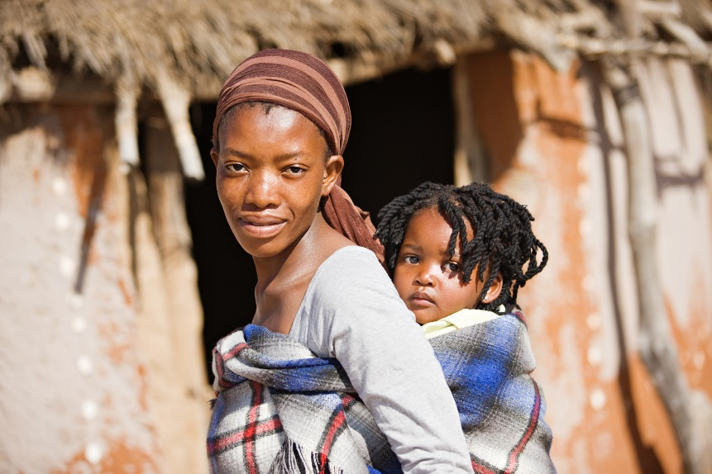
Yintoni eza kucelwa ukuba mabayenze abasetyhini ababhalise kwi-HOPE?
Abathathi-nxaxheba batshintsha ingqondo yabo ngokusebenzisa iringi naxa sele bejoyine uphando.
Khumbula, noko, ukuba iringi ingakhusela i-HIV xa isetyenziswa.
Notes:
Bonke abathathi-nxaxheba benza igalelo elibalulekileyo kuphando ukuba nje bathi baxelele abasebenzi bophando xa bangasebenzi iringi.

Slide 16
Bonke abathathi-nxaxheba, nokuba basebenzisa iringi, baza kucelwa ukuba:
Baphendule imibuzo emalunga nempilo yabo neendlela zokwabelana ngesondo
Bafumane ingcebiso ngokunciphisa umngcipheko nangeekhondom
Basebenzise indlela yocwangciso-ntsapho bathintele ukukhulelwa

Slide 17
Kolunye utyelelo, baxilongelwe impilo
Benze iimvavanyo zaselabhoratri, kuquka neemvavanyo ze-STIs, zokukhulelwa, neze-HIV
Banikezele ngeesampuli zegazi, ezeenwele, neesampuli ezithathwe ekukwini
Bonke abathathi-nxaxheba, nokuba basebenzisa iringi, baza kucelwa ukuba:

Slide 18
Kwenzeka ntoni ngabasetyhini abalandule ukubhalisa kwi-HOPE?
Ukuba umthathi-nxaxheba uthatha isigqibo sokuba akasafuni kubhalisa kwi-HOPE, uza kubuzwa ukuba uyafuna na ukuza kutyelelo olunye anikezele ngeenkcukacha zokuba kutheni elandula ukubhalisa.

Slide 19
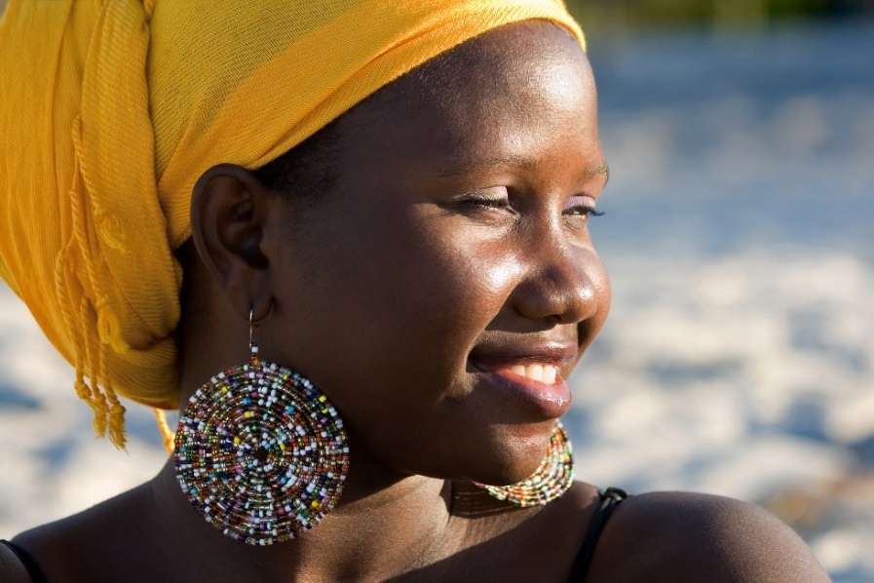
Kwenzeka ntoni ngabasetyhini abalandule ukubhalisa kwi-HOPE?
Abathathi-nxaxheba abalandula ukubhalisa bangatshintsha ingqondo yabo ze babhalise kwi-HOPE, kuxhomekeke ukuba uphando lusaqhuba na kwaye banazo iimfuneko zokulungela.

Slide 20
Yeyiphi imingcipheko?
Imingcipheko yokuthatha inxaxheba kwi-HOPE iyafana neye-ASPIRE:
Usengaziva ungakhululekanga okanye intlungu kwiindawo obuxilongwa kuzo okanye ekutsalweni kuzo igazi.
Iringi efakwa ekukwini ingenza abanye basetyhini bazive bengakhululekanga, abanye banganokurhawuzelelwa, babenedistshaji, okanye ezinye iimpawu.

Slide 21
Yeyiphi imingcipheko?
Usenganeentloni ngenxa yemibuzo neenkqubo ezikuphando.
Kungenzeka ukuba wena okanye iqabane lakho niyive iringi ngexesha lokwabelana ngesondo.

Slide 22
Yeyiphi imingcipheko?
In the unlikely event you become infected with HIV, you may develop drug resistance if you continue to use the ring.
It is possible that others may treat you unfairly or discriminate against you for participating in the study.

Slide 23
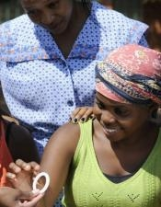
Yintoni iibhenefithi?
Ngexesha lokuthatha inxaxheba kuphando, abasetyhini abakwi-HOPE baza kunikwa iringi efakwa ekukwini efunyaniswe ikhuselekile nesebenza ngempumelelo ekuthinteleni i-HIV.

Slide 24
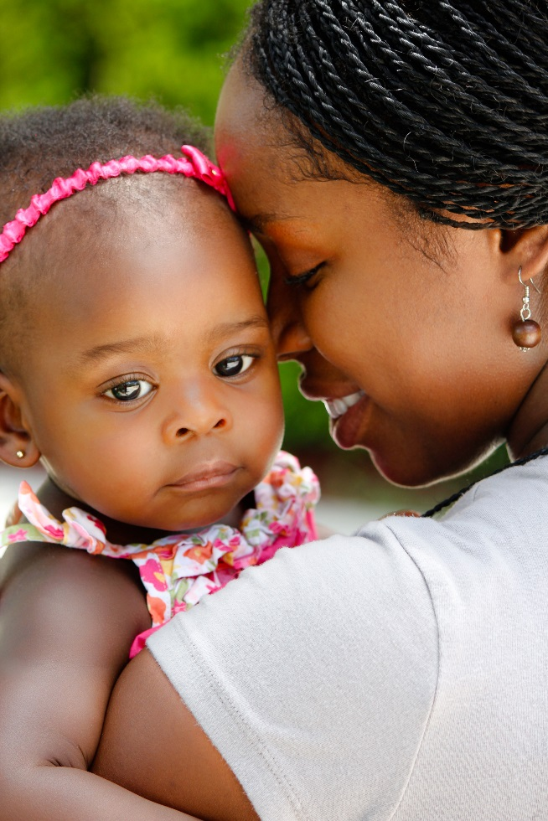
Yintoni iibhenefithi?
Abasetyhini abakuphando kananjalo baza kuxilongwa umzimba, iimvavanyo zokukhangela impilo yabo, ucwangciso-ntsapho, ingcebiso nge-HIV/STI novavanyo, nonyango okanye ukuthunyelwa kwenye indawo, njengoko kudingeka.

Slide 25
Yintoni enokwenziwa ngamaqabane nabantu ekuhlaleni?
Kubasetyhini abakulungeleyo, ukuthatha isigqibo sokujoyina i-HOPE nesokusebenzisa iringi kusini na yinto umntu azikhethela ngokwakhe. Abasetyhini bayakhuthazwa ukuba basixoxe isigqibo sabo namaqabane abo nabanye abantu ababalulekileyo kubo.
Notes:
Abasebenzi bophando baza kugcina iinkcukacha zabasetyhini abakuphando ziyimfihlo, kodwa bakwafumaneka ukuze bathethe nge-HOPE baze baphendule nayiphi na imibuzo abanayo amaqabane okanye abantu basekuhlaleni, njengoko kufuneka. Ngokuba nenkxaso, amaqabane nabantu basekuhlaleni bakwancedisa ukulwa i-HIV/AIDS.

Slide 26
Ukuba unemibuzo okanye ufuna ulwazi oluthe vetshe, nceda undwendwele ikliniki yophando

